Slide 1
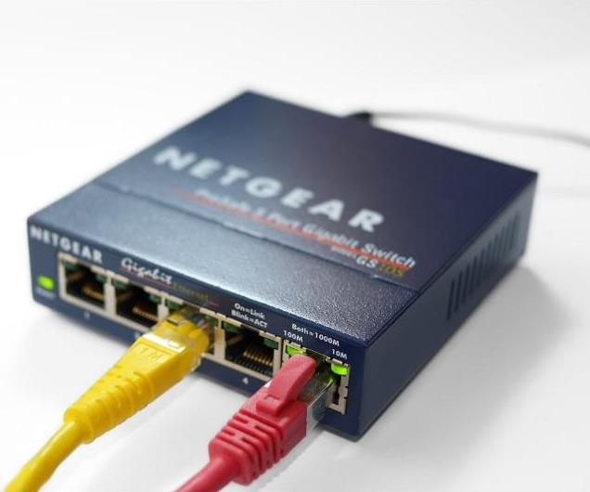
Network hardware
Y12 - Cambridge International 9618 | 2.1.6
Photo: Simon A. Eugster, CC BY-SA 3.0, Wikimedia Commons
1
Notes:
Covers syllabus 2.1: "Describe the hardware that is used to support a LAN" (switch, server, NIC, WNIC, WAP, cables, bridge, repeater) and "Describe the role and function of a router in a network". Hub, MAC address and modem are not named in the syllabus, but they appear in mark schemes, so they are included. Ethernet and CSMA/CD come next lesson (textbook 2.1.7).
All photos are from Wikimedia Commons under free licences; full credits are on the last slide.

Slide 2
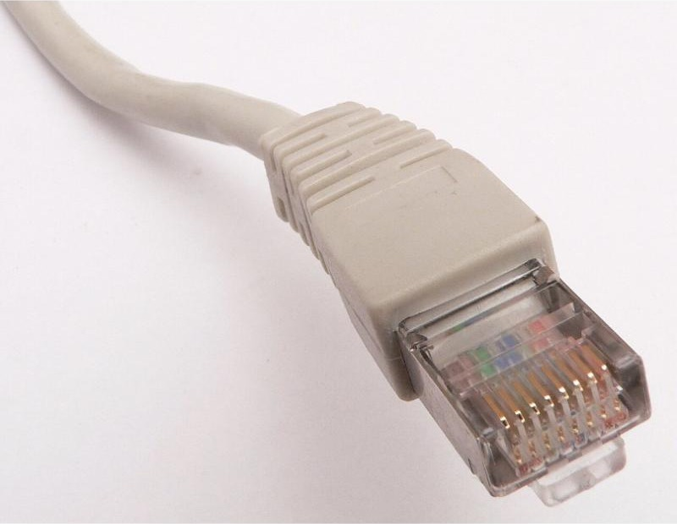
Recall test: wired and wireless
Starter activity
Worksheet Task 1 covers... | Marks
Q1 Which cable? Twisted pair, coaxial or fibre optic | 3
Q2 Identify and describe two transmission media (9618/13 Nov 2024) | 4
Q3 Wired or wireless for films and games? Justify | 3
Photo: David Monniaux, CC BY-SA 3.0, Wikimedia Commons
1
Closed book - 7 minutes
No notes, no slides. Write as much as you can, then swap and mark with a different colour pen.
2
Why?
Today's devices sit on top of last lesson's cables and radio waves - repeaters exist because signals fade along a cable.
2
Notes:
Worksheet Task 1 - closed book, 7 minutes, then swap and mark from the answer key. It checks last lesson (2.1.5). Q2 is a real question: 9618/13 Oct/Nov 2024 Q9(b). Q3 is based on 9618/11 May/June 2021 Q4(c)(ii).
Re-teach threshold: fewer than 2/4 on Q2 means recap fibre vs radio/microwaves before slide 12.

Slide 3
In this lesson, you will
Objectives
Identify the hardware used to support a LAN: switch, server, NIC, WNIC, WAP, cables, bridge and repeater
Explain how a switch forwards data using MAC addresses, and why it beats a hub
Describe the role and function of a router, using the technical detail examiners expect
Tell MAC addresses and IP addresses apart
Write full-mark answers to "describe the purpose of..." exam questions
3

Slide 4
Spot the hardware
Activity 1
Main building (LAN segment 1)
Sports hall, 150 m away (segment 2)
B
C
Laptop
E
PC
?
PC
D
F
A
Laptop
PC
?
?
?
Switch
G
150 m cable
PC
Internet
PC
PC
?
H
Name devices A to H. Which ones are inside a computer? Which one joins the school to a different network?
4
Notes:
Think-pair-share, 3 minutes: which device is each letter? Worksheet Task 2(a) uses this diagram.
Answers (revealed on slide 18): A switch, B server, C wireless access point, D WNIC (inside the laptop), E NIC (inside the PC), F bridge, G repeater, H router.
Prompt questions: Why does the sports hall need G? (150 m is past the ~100 m limit of twisted pair, so the signal fades.) Why is F a bridge and not a router? (both segments are the same school LAN, same protocol.)

Slide 5
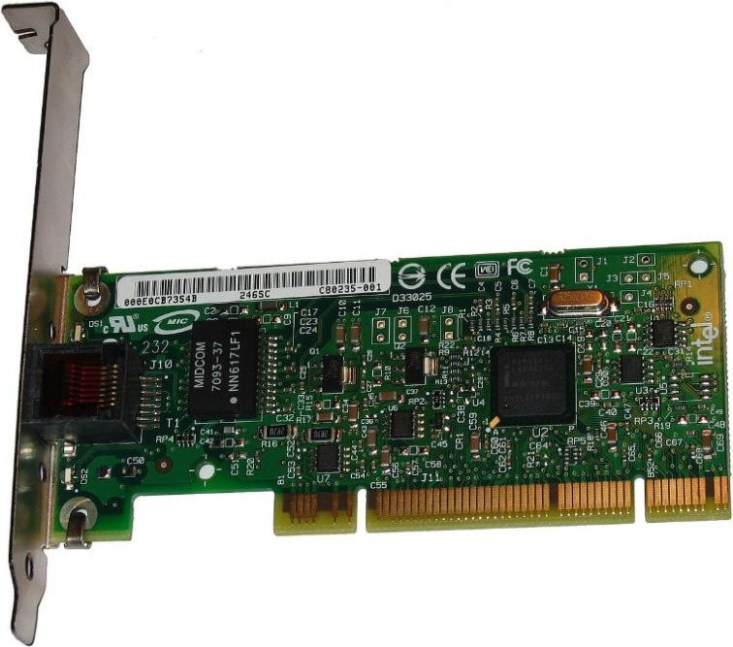
Network Interface Card (NIC)
Activity 2
What it does
Lets a device connect to a (wired) network - every device on a LAN needs one
Converts the computer's data into signals for the cable, and back again
Holds the device's unique MAC address, set when it is made
00 : 1A : 2B : 3C : 4D : 5E
manufacturer ID (first 24 bits)
serial number of the device
A PCI network card Photo: ktims, Public domain, Wikimedia Commons
MAC address: a 48-bit physical address, written as 12 hex digits, that uniquely identifies a device on a network. It does not change.
5
Notes:
A NIC is needed for any device to connect to a network. Today it is usually built into the motherboard, but the job is the same. Key exam fact: the NIC holds the device's MAC address, set at manufacture. Wired NICs are for Ethernet (twisted pair cable).
MAC = Media Access Control. 48 bits = 12 hex digits, often written as 6 pairs. The first half identifies the manufacturer, the second half is the device serial number. Hub and MAC address are not named in the syllabus, but MAC appears in many router, switch and WNIC marking points.

Slide 6
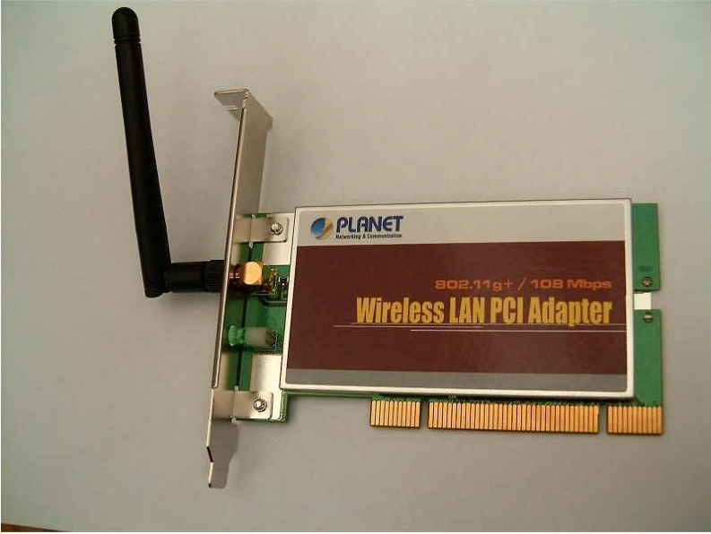
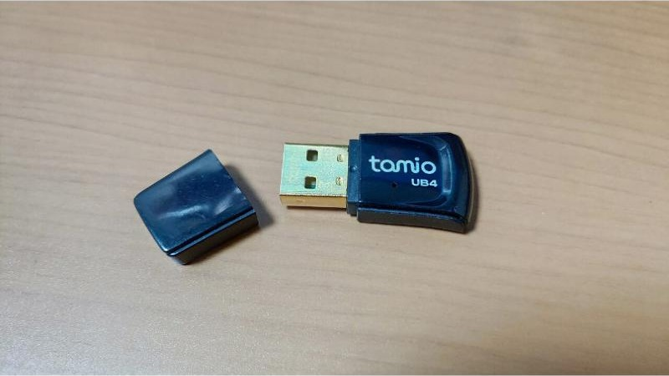
Wireless NIC (WNIC)
Activity 2
1
Antenna
2
Converts
Sends and receives radio waves - the device's interface to the wireless network
Analogue radio waves in -> digital data for the CPU; digital data out -> radio waves
3
Filters
4
Secures
Checks the MAC address on each incoming transmission and ignores data not meant for it
Encrypts data before sending and decrypts data it receives
Internal card Photo: unknown, Public domain, Wikimedia Commons
Like a NIC, it provides the device's MAC address - NOT its IP address.
Infrastructure mode: connects through a WAP. Ad hoc mode: devices connect directly to each other.
USB adapter Photo: OnionBulb, CC BY-SA 4.0, Wikimedia Commons
6
Notes:
Official marking points for "Describe the functions of a WNIC" (9618/11 & 13 Oct/Nov 2021 Q8(c), [4]): provides an interface to the wireless network as an antenna; receives analogue radio waves and converts them to digital; checks incoming transmissions for the correct MAC/IP address and ignores those not for it; encrypts/decrypts data; takes digital data, converts it to analogue radio waves and sends them via the antenna.
Examiner report: "a frequent misconception that the WNIC provided an IP address rather than a unique MAC address", and "a WNIC functions like a NIC, but wirelessly" was not precise enough.
Modes (textbook): infrastructure mode goes through a WAP; ad hoc mode connects devices directly.

Slide 7
MAC address vs IP address
Activity 2
 | MAC address | IP address
Type of address | Physical - belongs to the NIC / WNIC | Logical - belongs to the connection
Who sets it? | The manufacturer | The router (private IP) or the ISP (public IP)
Does it change? | No - fixed for the device | Yes - can change when the device moves network or reconnects
Format | 48 bits, e.g. 00:1A:2B:3C:4D:5E | IPv4: 32 bits, e.g. 192.168.0.12
Used by... | Switches - to deliver data inside the LAN | Routers - to send packets between networks
Quick check: your laptop moves from home Wi-Fi to the school network. Which address changes, and which stays the same?
7
Notes:
This contrast underpins the rest of the lesson: switches work with MAC addresses inside a LAN; routers work with IP addresses between networks. Private IP addresses are "assigned by the router within the LAN" (9618/12 May/June 2025 Q6(c)). IP addressing is covered in detail later in 2.1/2.2 - keep it light here.
Quick check: a laptop moves from home to school. Which address changes? (IP - it is given a new private IP by the school router. The MAC stays the same.)

Slide 8
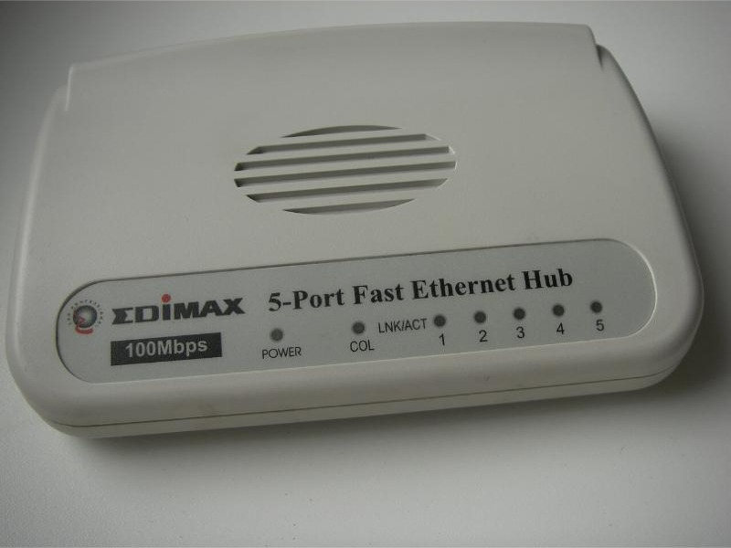
Hub vs switch
Activity 3
PC1
PC2
Hub
Sends every packet to ALL devices
Wastes bandwidth; any device can read the data
Hub
PC3
PC4
Hub Photo: George Shuklin, Public domain, Wikimedia Commons
PC1 sends to PC3 through a hub
PC1
PC2
Switch
Reads the destination MAC address
Sends the data ONLY to that device
Switch
PC3
PC4
PC1 sends to PC3 through a switch
Switch Photo: Simon A. Eugster, CC BY-SA 3.0, Wikimedia Commons
8
Notes:
Both connect devices in a star topology. A hub broadcasts every packet to every port: wasteful of bandwidth, more collisions, and insecure (every device sees all traffic). A switch reads the destination MAC address and sends the data only to that device.
Hubs are not in the syllabus but are credited as a connecting device (9618/11 Oct/Nov 2021 Q8(b)) and appear as a distractor: "directs each packet to all devices attached to it" is NOT done by a router (9618/11 May/June 2021 Q4(c)(i)).
Examiner report (9618/12 May/June 2025): candidates must "make it clear that the switch sends only to the intended recipient".

Slide 9
How a switch forwards data
Activity 3
1
Receives
Port | MAC address of device | Device
1 | 00:1A:2B:3C:4D:5E | PC1
2 | 00:1A:2B:7F:01:9C | PC2
3 | A4:83:E7:10:22:6B | PC3
4 | 3C:22:FB:55:0A:11 | Server
A packet arrives from a device on one of its ports
2
Reads
It reads the destination MAC address in the packet
3
Looks up
The switch's MAC address table (it learns it automatically)
It checks its table of MAC addresses to find the port that device is on
Quick check: a packet arrives for A4:83:E7:10:22:6B. Which port does the switch send it out of? Which devices never see it?
4
Forwards
It sends the packet only out of that port, to the intended recipient
A switch provides a central point of connection in a star topology, so connected devices can communicate.
9
Notes:
Official marking points for "Describe the role of a switch in a network" (9618/12 May/June 2025 Q6(e), max 3): stores the MAC addresses of devices connected to it; receives packets from devices; forwards packets directly to the intended recipient; provides a central point of connection; enables connected devices to communicate.
Examiner report: "A common incorrect answer was, 'to turn the network on and off'." On a home network the router box contains the switch.
The MAC address table is built automatically: the switch notes the source MAC of each frame and the port it came in on.

Slide 10
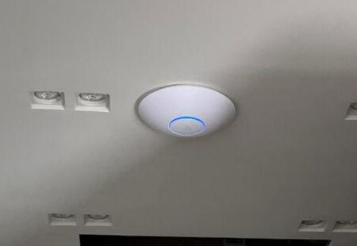
Wireless access point (WAP)
Activity 4
Purpose
Connects wireless devices to a WIRED network - it is cabled to a switch
Sends and receives radio (Wi-Fi) signals between the wired network and each device's WNIC
Large sites need several WAPs to cover every room
Weak answer (0 marks) | Full-mark answer
"It gives wireless access" | Lets wireless devices connect to the wired LAN, using radio waves to send and receive data between the switch and each device
Ceiling-mounted WAP Photo: Sabbo91, CC BY-SA 4.0, Wikimedia Commons
At home, the WAP is built into the "router" box.
Laptop
Switch
WAP
cable
Phone
radio waves
10
Notes:
Official purpose (9618/11 Oct/Nov 2023 Q2(b)): to allow devices to connect to the central device using radio signals / Wi-Fi; to allow the central device to send/receive radio (Wi-Fi) signals; to allow wireless-enabled devices to connect to a wired network. (9618/12 May/June 2022 Q9(a)): hardware that provides radio communication from the central device to nodes on the network, and vice versa.
Examiner reports: "allows a device to connect wirelessly" is not clear enough, and "a WAP provides a wireless access point" just expands the acronym and earns nothing.
The photo shows a ceiling-mounted WAP like the ones in most schools: a cable (often with power over Ethernet) runs from it to a switch.

Slide 11
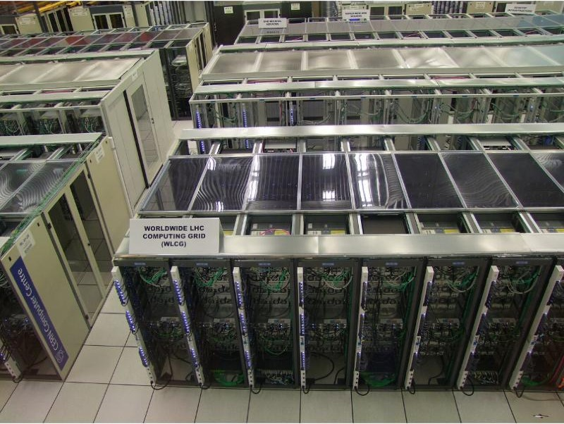
Servers
Activity 4
Type of server | Service it provides to clients
File server | Stores users' files centrally, with access rights and back-ups
Print server | Manages a queue of print jobs for shared printers
Email / web server | Stores and sends email; stores and sends web pages
Authentication server | Checks usernames and passwords at log-on
A server is a computer that provides a service or resources to clients. It does NOT connect the devices together - the switch does.
Server racks in a data centre Photo: Marián Hubinský, CC BY-SA 4.0, Wikimedia Commons
1
Client
2
Server
Sends a request to the server, then waits for the response
Receives and processes requests, then sends back the response
11
Notes:
A server is a computer (hardware), usually more powerful than a client, that provides a service to the other computers (clients) on the network. Link back to client-server model (2.1.2). Servers in a school are usually in racks in a server room, connected to a core switch.
Careful: a server does not connect devices together. In 9618 Specimen Paper 1 Q2(d)(i) ("identify three items of hardware" that connect a LAN) the mark scheme says "Do not award cables, computers, servers".
One exam (9618/12 Oct/Nov 2022 Q10(b)(i)) accepts attaching the router to the server because "it processes requests and authorises traffic // firewall software on the server".

Slide 12
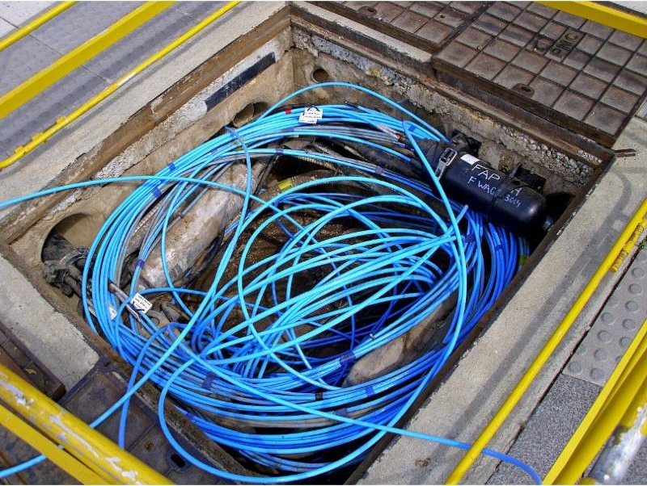
Cables: copper and fibre
Activity 4
 | Copper (twisted pair) | Fibre optic
Signal | Electrical signals | Pulses of light
Bandwidth | Lower | Higher - faster transmission
Interference | Affected by electrical noise | Not affected (light)
Distance before a repeater | Short (~100 m) | Much longer
Security | Easier to tap | Much harder to hack into
Cost / handling | Cheap, flexible | Costly, more prone to damage
Twisted pair, RJ45 plug Photo: David Monniaux, CC BY-SA 3.0, Wikimedia Commons
Use: twisted pair to each desk; fibre for long links between buildings and the "backbone".
Fibre-optic cables Photo: Bidgee, CC BY-SA 2.5 AU, Wikimedia Commons
12
Notes:
Recap from 2.1.5. Official marking points, 9618/12 May/June 2022 Q9(b) "Describe three differences between fibre-optic cables and copper cables" [3]: fibre uses light, copper uses electrical signals; fibre has higher bandwidth / transmission rate; fibre has a smaller risk of (noise) interference; fibre can be used over longer distances before repeaters are needed; fibre is much more difficult to hack into; fibre is more prone to damage.
Useful link to the next slide: every cable has a maximum length (about 100 m for twisted pair) because signals lose strength (attenuation).

Slide 13
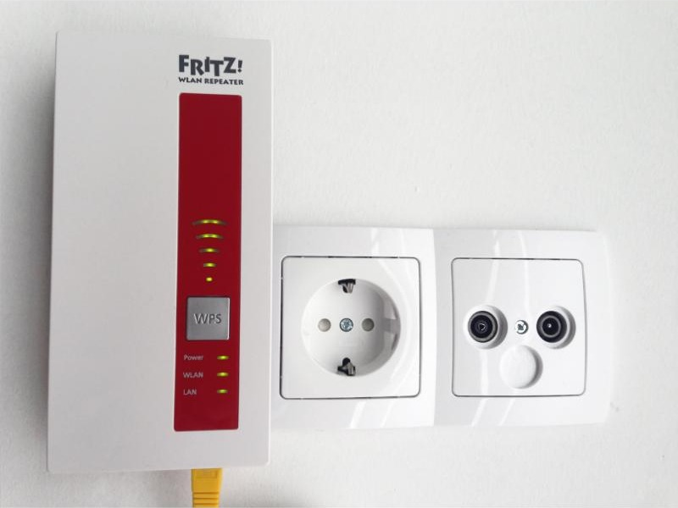
Repeater
Activity 5
Repeater
Signal strength along a long cable: it fades (attenuation), then the repeater restores it
Wi-Fi repeater in a wall socket Photo: Blingooo, CC BY-SA 4.0, Wikimedia Commons
Purpose
Restores (boosts) a signal that has weakened over distance, so it can travel further
Wired (copper or fibre) or wireless - Wi-Fi repeaters remove "dead spots"
13
Notes:
Official description (9618/12 May/June 2022 Q9(a)): "Restores the digital signal so it can be transmitted over greater distances" - candidates had to name the device: Repeater.
Textbook points: signals suffer attenuation (signal loss) over long distances; repeaters boost the signal so it can travel further; used on copper and fibre links, and as Wi-Fi repeaters (range extenders) to remove dead spots. They are "non-logical": they boost every signal they detect, without reading addresses.
Misconception: a repeater does not filter, route or speed up data - it only restores signal strength.

Slide 14
Bridge
Activity 5
LAN segment 1 - Ethernet
LAN segment 2 - Ethernet
PC
PC
PC
Switch
Bridge
Switch
PC
same protocol both sides
PC
PC
Purpose
Bridge or router?
Connects two LANs (or two segments of one LAN) that use the SAME protocol, so they work as one network.
Same protocol, same organisation, acting as one LAN: bridge. Joining a LAN to a different network (e.g. the internet): router.
14
Notes:
Official purpose (9618/11 Oct/Nov 2023 Q2(b)): to connect two LANs / segments with the same protocol // to transmit data between two networks with the same protocol.
Textbook: bridges connect one LAN to another LAN that uses the same protocol, often to join parts of a LAN so they function as a single LAN. A bridge only passes on data meant for the other side, so it stops each segment flooding the other with traffic. To connect to a different network, such as the internet, a router is used.
Watch out: 9618/12 May/June 2022 Q9(a) gives the description "Receives and sends data between two networks operating on the same protocol" and its published mark scheme answer is "Router". That description matches the textbook's definition of a bridge. Teach "bridge"; see the answer key note.

Slide 15
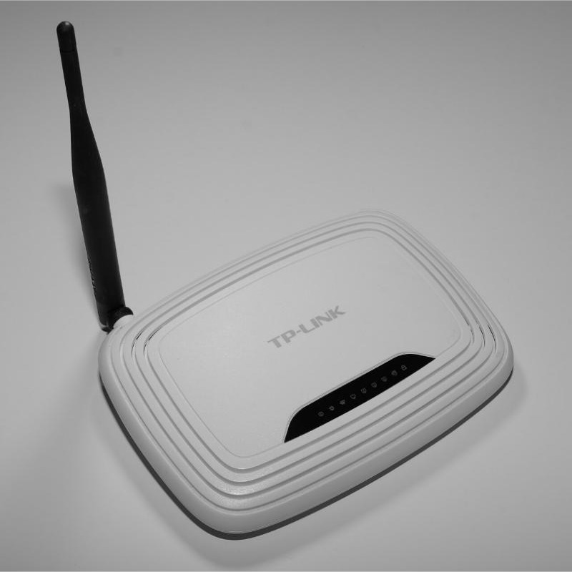
Router: role and function
Activity 6
1
Receives packets
2
Reads the destination IP
from devices on the LAN, or from the internet
address in each packet's header
3
Uses its routing table
4
Forwards the packet
to find the most efficient route; keeps the table up to date
to the next router / network, or to the device on the LAN
Wireless router Photo: Hayden Schiff, CC BY 4.0, Wikimedia Commons
5
Assigns private IPs
6
Protects and converts
to LAN devices; has the public IP the internet sees (NAT)
acts as a firewall and gateway; converts the packet format between networks
"It connects the LAN to the internet" = 0 marks. Talk about packets, IP addresses and the routing table.
15
Notes:
The most-examined device (about 8 question parts since 2021). Official marking points combined from 9618/11 Oct/Nov 2023 Q2(a), 9618/12 Oct/Nov 2022 Q10(b)(ii), 9618/12 Oct/Nov 2021 Q3(b)(ii), 9618/12 May/June 2024 Q3(c)(i): receives packets from devices / the internet; analyses the destination IP address of each packet; forwards the packet towards its destination using the routing table; maintains / updates the routing table; finds the most efficient route; assigns private IP addresses to devices on the LAN; provides the LAN with a public IP address / NAT; maintains a table of MAC and IP addresses; acts as a gateway; performs protocol conversion / changes the packet format for the next network; acts as a firewall.
Examiner reports: "the router connects the LAN to the Internet" is too superficial; good answers talk about receiving and forwarding packets and IP/MAC addresses.

Slide 16
A packet leaves the LAN
Activity 6
PC1
1
Internet:
more routers
2
3
4
Switch
Router
Web server
PC2
1 PC1 sends the packet to the switch
2 The switch forwards it to the router - the LAN's way out (default gateway)
3 Router reads the destination IP, checks its routing table, forwards it
4 Each router repeats this until the packet arrives
 | Switch | Router
Works within... | one LAN | between networks (LAN to WAN / internet)
Address it reads | MAC address | IP address
Decides using | its MAC address table | its routing table
16
Notes:
Walk through the numbered path. Within the LAN the switch delivers using MAC addresses; to leave the LAN, packets go to the router, which reads the destination IP address and forwards them using its routing table. Each router on the internet repeats this until the packet reaches the destination network (9618/12 May/June 2024 Q3(c)(i)).
Router vs switch is the key contrast. A router can join networks that use different protocols (e.g. Ethernet LAN to a Wi-Fi network, or to the ISP's network).

Slide 17
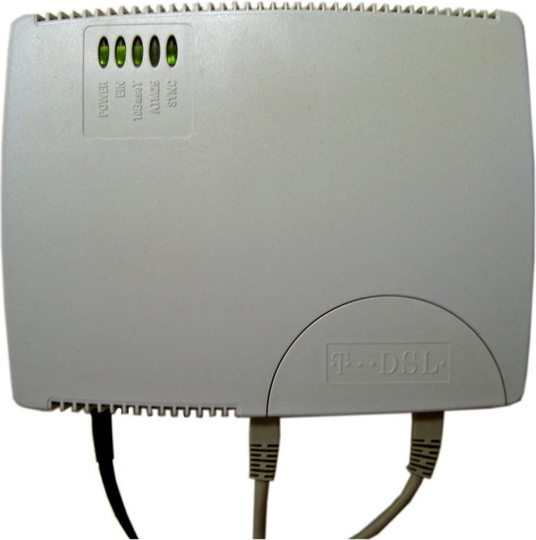
Modem - and the box you call a "router"
Activity 6
One home "router" box contains...
Router
forwards packets between home LAN and ISP; assigns private IPs
Switch
the LAN ports for wired devices
WAP
Wi-Fi radio for wireless devices
Modem
converts signals for the phone / cable line
DSL modem Photo: Heidas, CC BY-SA 3.0, Wikimedia Commons
Firewall
filters traffic in and out
Modem
Converts digital data to analogue signals to send down a phone line, and analogue back to digital.
In an exam, name the part that does the job: "the WAP in the router lets the phone connect".
17
Notes:
Modem (MOdulator DEModulator) is internet hardware (syllabus: "Describe the hardware that is used to support the internet": modems, PSTN, dedicated lines, cell phone network). Official point (9618/11 May/June 2025 Q2(c)): converts digital data into analogue for transmission down phone lines // converts analogue back into digital after transmission.
The home "router" is really several devices in one box. Students should name the device that does the job in the question, e.g. "the WAP in the router" - examiner report 9618/12 Oct/Nov 2021: "It asked for functions of the router not the WAP".

Slide 18
Spot the hardware: answers
Check your answers
Main building (LAN segment 1)
Sports hall, 150 m away (segment 2)
B
Server
C
Laptop
E
PC
WAP
PC
D
F
A
Laptop
PC
Switch
Bridge
Repeater
Switch
G
150 m cable
PC
Internet
PC
PC
Router
H
D = WNIC inside each laptop. E = NIC inside each PC. G boosts the signal on the 150 m link. F joins two segments of the same LAN.
18
Notes:
Reveal after Task 2(a). Go round the class: for each device, one sentence on its purpose using the slide wording.

Slide 19
Exam focus: the router
Exam focus
9618/11 Oct/Nov 2023 Q2(a) A school has a LAN. The LAN connects to the internet using a router. Describe the function of a router in a network. [3]
Official marking points (any 3)
Receives packets from the internet / external network | Analyses the destination IP address of each packet
Forwards the packet towards its destination... | ... using the routing table
Maintains / updates the routing table | Finds the most efficient route to the destination
Allocates private IP addresses | NAT: lets many devices share one public IP
Implements a firewall | Changes the packet format for the next network
No marks
Full marks
"It connects the school to the internet" - this is already in the question.
"It receives packets, reads each destination IP address and forwards them using its routing table."
19
Notes:
Show AFTER students attempt worksheet Task 4. 9618/11 Oct/Nov 2023 Q2(a) [3] - official marking points (max 3) shown. Examiner report: "Many candidates need to improve their understanding of the function of a router in a network... answers are expected to include more technical detail, rather than general knowledge."

Slide 20
Exam focus: describing a device
Exam focus
Device | Credited purpose (official wording, shortened)
Switch | Receives transmissions and forwards them to their destination // connects devices so they can communicate
WAP | Allows wireless-enabled devices to connect to a wired network using radio signals / Wi-Fi
Bridge | Connects two LANs / segments that use the same protocol
Repeater | Restores the digital signal so it can be transmitted over greater distances
WNIC | Allows a device to connect to a wireless network // provides a MAC address to identify it on the network
1
Don't expand the acronym
2
Use the key nouns
3
Don't repeat the stem
Say what the device DOES and how
packets, MAC / IP address, protocol, radio waves
If the question says it connects to the internet, that earns nothing
20
Notes:
Show AFTER worksheet Task 5. Official points from 9618/11 Oct/Nov 2023 Q2(b) [3] (1 per device), 9618/11 and /13 Oct/Nov 2021 Q8(c) [4] and 9618/12 May/June 2022 Q9(a) [4].
Examiner report patterns: expanding the acronym ("a WAP provides a wireless access point") earns nothing; "a WNIC acts like a NIC in a wireless network" is too vague; WNICs provide a MAC address, not an IP address.

Slide 21
Guided practice
Activity 7
Task | What you do | Marks
1 Recall test | Wired and wireless - closed book | 10
2 Identify | Name devices A-H on the school LAN; match devices to descriptions | 12
3 Apply | Router tick table; trace a packet through a hub and a switch; MAC or IP? | 10
4 Exam questions: router | Real 9618 Paper 1 questions on the router | 7
5 Exam questions: LAN devices | Real 9618 Paper 1 questions on switch, WAP, bridge, WNIC | 12
6 Extension | Draw a star network (9618/12 June 2025) and design a school network | 10
Check your work against the answer key when your teacher shares it.
21
Notes:
Most students should finish Tasks 1-5 in the lesson; Task 6 is extension or homework. Real past-paper questions are cited under each part.

Slide 22
Common misconceptions
Plenary
Misconception | Why it is wrong
"A router connects devices to the internet" is enough | Too vague - describe receiving packets, reading the destination IP and forwarding using a routing table
A switch sends data to every device | That is a hub. A switch reads the MAC address and sends only to the intended device
A WNIC gives a device its IP address | The NIC / WNIC holds the MAC address. The router (or ISP) gives the IP address
A WAP "provides wireless access" | Says nothing new. It connects wireless devices to the wired LAN using radio waves
A server connects the network together | A server provides services to clients. Switches connect devices
A bridge and a router do the same job | A bridge joins LANs using the same protocol; a router joins different networks
A repeater speeds up the network | It only restores a weakened signal so it can travel further
22
Notes:
Sources: Principal Examiner reports for 9618 Paper 1 (Nov 2021, June 2022, Nov 2022, Nov 2023, June 2025) and the textbook. Ask students which ones they believed at the start of the lesson.

Slide 23
Exit question
Plenary
On a sticky note or mini-whiteboard:
a
Switch vs hub
Explain why a school uses a switch rather than a hub to connect 30 computers. [2]
b
Bridge vs router
State one difference between a bridge and a router. [2]
23
Notes:
Model answer (2 marks for (a), 2 for (b)):
(a) A switch reads the destination MAC address (1) and sends the data only to that device (1) // a hub sends the data to every device (1).
(b) A bridge joins two LAN segments that use the same protocol so they act as one LAN (1); a router forwards packets between different networks using IP addresses / a routing table (1).

Slide 24
In this lesson, you
Summary
Identified the hardware that supports a LAN: switch, server, NIC, WNIC, WAP, cables, bridge, repeater
Saw how a switch uses MAC addresses to send data only to the intended device - unlike a hub
Described the role and function of a router: packets, IP addresses, routing table, private IPs, firewall
Separated MAC addresses (physical, fixed) from IP addresses (logical, can change)
Practised full-mark device descriptions from real 9618 Paper 1 questions
Next lesson: Ethernet and CSMA/CD - what happens when two devices transmit at the same time?
24
Notes:
Next lesson: Ethernet and CSMA/CD (textbook 2.1.7) - how devices sharing a network detect and deal with collisions. Edit if your scheme differs.

Slide 25
Photo credits
Credits
Photo | Author | Licence
Netgear Gigabit Switch 5-port | Simon A. Eugster | CC BY-SA 3.0
Edimax Ethernet Hub | George Shuklin | Public domain
TP-Link TL-WR740N router | Hayden Schiff | CC BY 4.0
Access Point UniFi | Sabbo91 | CC BY-SA 4.0
Intel PRO-1000 GT PCI NIC | ktims | Public domain
Planet WL-8310 | unknown | Public domain
Tamio UB4 WiFi/Bluetooth USB adapter | OnionBulb | CC BY-SA 4.0
Rack of Worldwide LHC Computing Grid | Marián Hubinský | CC BY-SA 4.0
Ethernet RJ45 connector | David Monniaux | CC BY-SA 3.0
Fibre-optic cable in a Telstra pit | Bidgee | CC BY-SA 2.5 AU
Fritz WLAN repeater an der Steckdose | Blingooo | CC BY-SA 4.0
T-DSL Modem | Heidas | CC BY-SA 3.0
All photos from Wikimedia Commons (commons.wikimedia.org), used under the licences shown. Cropped for layout.
25

